Slide 1
Back into school: Why is attendance important?

Slide 2
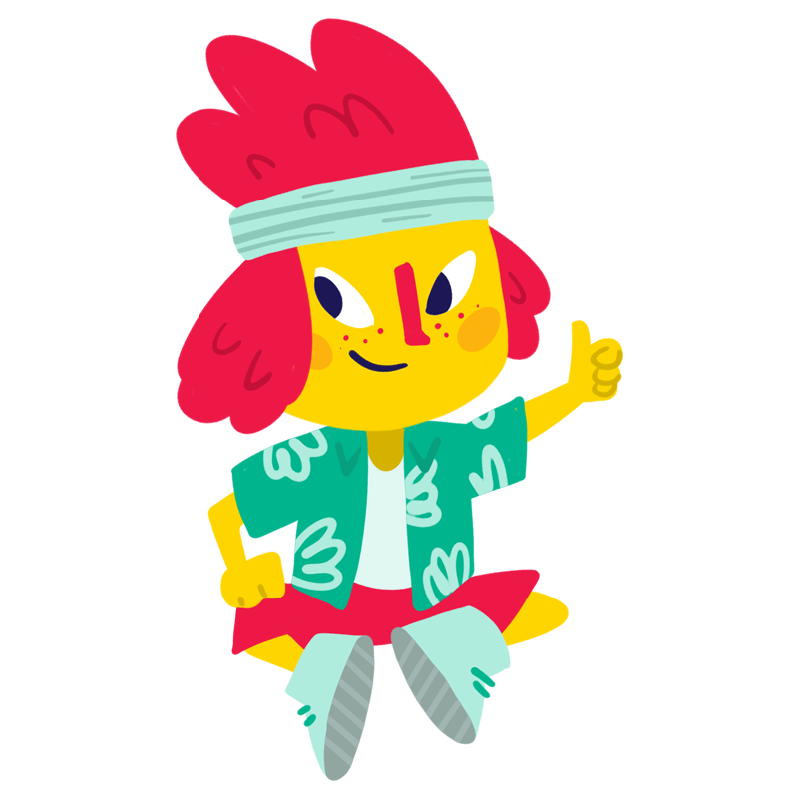
First of all, what do you think?
Why do you like going to school?
“Something that motivates me going to school, is when I learn today, I can have a very good job when I am older”
- Girl, 9
Notes:
This is an opportunity for the students to talk amongst themselves and think about what opportunities school, (and the move to secondary school, might bring them).
Ask the children to turn to their neighbour and think about these – ask some of them to share some of their ideas
Talk about the importance of coming to school - get the children to think about what difference attending school might have on their future.
Ask them to discuss this in pairs and then ask some of them to share
The reality is – attending school provides you with so many opportunities…

Slide 3
I get to go to breakfast club before school
I can join after school clubs
I can try out a musical instrument
Spending time with my friends
I get to learn new things
I like talking to my teacher
I can get involved with fun sports
School trips and new experiences
I get to learn new languages
I can make things in arts and craft
Notes:
(This slide can be tailored to your cohort.)
These are just some of the opportunities that we have thought of – there are so many opportunities that are coming your way – I really want you to make sure you are making the most of these and they are all found in school!
(This is an opportunity to get the children excited about what they might want to do/take advantage of.)
The most obvious one is that it means you can get qualifications to do the jobs you want to do or that will allow you to get jobs in the future, even if you don’t know what you want to do now.
But, there are so many other opportunities school provides, meeting friends, learning new skills that will help you throughout life e.g team work, communication, problem solving. Getting new experiences e.g. sports clubs and hobbies, school trips, being creative.

Slide 4

Do you have any worries about going to school? Close your eyes and put up your hand if you have any worries
“It can be stressful at times”
- Boy, 13
Notes:
[Option to do a pre-assembly task where the class are asked to write any worries down and put in a hat/something anonymous and then they can share some of these anonymously in the lesson?]
Interactive hands up hands down game. Close your eyes - hands up if have any worries or concerns about going to secondary school and hands down if you have none.
Give them some examples from what children have told us are common worries and then say if you have worries you can speak to your teachers/…(for school to insert if they have someone else to talk to)
It is completely normal to be nervous or worried about going to school – I know it can feel scary on some days. It can also be really hard starting in a new year. Your teachers will be different, maybe some of your friends, your journey to school. Change can be scary but with it comes so many exciting opportunities as Rachel said.
Give the children an opportunity to discuss their worries with their neighbour. It’s important that you address these worries with practical solutions and ways they can manage them. I.E if they tell you they are scared they are going to get bullied remind them that this is common worry but that lots of children think this before they go to school. Remind them who they can go to talk to and how to support other children if they see them being bullied.

Slide 5

What things might prevent you from going to school? How can we help?
“Sometimes if I do something embarrassing in class”
- Boy, 11
Notes:
We know that sometimes, children have to miss school. During Covid we missed a lot of it and now we want to make sure that we are doing everything possible to ensure we can attend.
Hands up if you’d like to share (Get a few pupils to share their ideas.)
There are loads of things we can do to get more support – make sure we are in school and make the most of it when we are there.

Slide 6
Quick quiz
How many days are there in a year?
How many days are you expected to be in school?
How many minutes a day would you have to miss to be considered persistently absent?
How many days of school will you miss each year if you are late 30 minutes each day?
Notes:
Ask the children to shout out:
How many days are there in a year? 365
How many of those days are you supposed to be in school? 190
That’s 175 days that you get to spend doing what you want – that’s loads!
If you spend 190 days in school – this will give you the very best chances of success
We don’t want any children to be what schools name ‘persistently absent’ – as this means you are going to find it really hard to succeed in school. How many days do you think you have to miss before you are considered persistently absent? 18 days
And that sounds like a lot – doesn’t it? It is, but it can easily add up.
But – if you miss 30 minutes of school a day – this could be by running five minutes late to every lesson or 15mins late at start of day and 15mins late after lunch. This amounts to 19 days lost each year.
I want to make sure that each and every one of you don’t find yourselves in this positions. Because, it means you are going to be less likely to take advantage of and excel in all of those opportunities we spoke about just now.
There are loads of unintended consequences if you don’t attend school, so set yourself a target of 190 days a year!

Slide 7

What things can you do every day to make sure you attend school?
“I think children should go to school because there are so many people that support you, there’s friends that you can make friends with and they’re really lovely”
- Girl, 9
Notes:
Talk to the person next to you, what things could you do in the morning to make sure you attend school? What things could you do in the evening?
There are lots of things that can help get you to school everyday…

Slide 8
Get a good amount of sleep
Know who you can talk to if you are struggling with your wellbeing or your studies
Know your journey to school and leave on time
Have a nutritious breakfast – sometimes you can get this from school
Look out for your friends
Do your homework
Notes:
These are some of the ways that we think you can give yourself the best chance of being in school and making the most of school:
Make sure you are getting enough sleep: this will help you get up on time in the mornings and will also help you stay focused in your lessons. It can help your memory and also regulate your emotions!
Make sure that you are having a nutritious breakfast: breakfast is the most important meal of the day! So make sure that you are preparing yourself for a full day of learning with a hearty meal!
Make sure that you know your journey to school: having a new journey can be daunting so make sure that you know how to get to school so you aren’t late on your first day!
Know who you can talk to: This might be your form tutor, your favourite teacher, or someone who is responsible for everyone’s wellbeing – make sure that you know who the person to go to is when things are getting too tough!
Look out for your friends: This one is so important – look out for your friends. If you notice one of your friends is struggling or struggling to attend school ask them how you can help and if you are really worried make sure you let a teacher know.

Slide 9

Back into School
Our Back into School page has a collection of videos, games and places you can find support.
https://www.childrenscommissioner.gov.uk/back-into-school/resources-for-children-and-young-people/

Slide 10
Who should I speak to if I am finding it hard to go to school?
Insert photo
Insert photo
Insert photo
Insert name
Insert name
Insert name
Notes:
{On this slide insert pictures of the class teachers and main leads on attendance}
Now – as I said, all of those worries that we spoke about at the beginning are completely normal. It is so important that if you feel at all wobbly about going into school that you know that you have people that you can go and talk to.
If you are feeling upset or worried, you can always tell your class teacher. This year, you’ll be taught by {INSERT NAME}. {INSERT NAME} is very friendly and is always happy to help. {INSERT FUN FACT ABOUT TEACHER}
At your school, you can also talk to {INSERT NAME AND ROLES OF OTHER PROFESSIONALS WHO CHILDREN SHOULD SPEAK TO}.
If you would like someone from your family to have a talk to us, the best person to speak to is {INSERT MAIN ATTENDANCE LEAD AT SCHOOL}.
We’re all here to help you to come to school. We want you to enjoy being in school each and every day.

Slide 11
Thank you and good luck!

