Slide 2
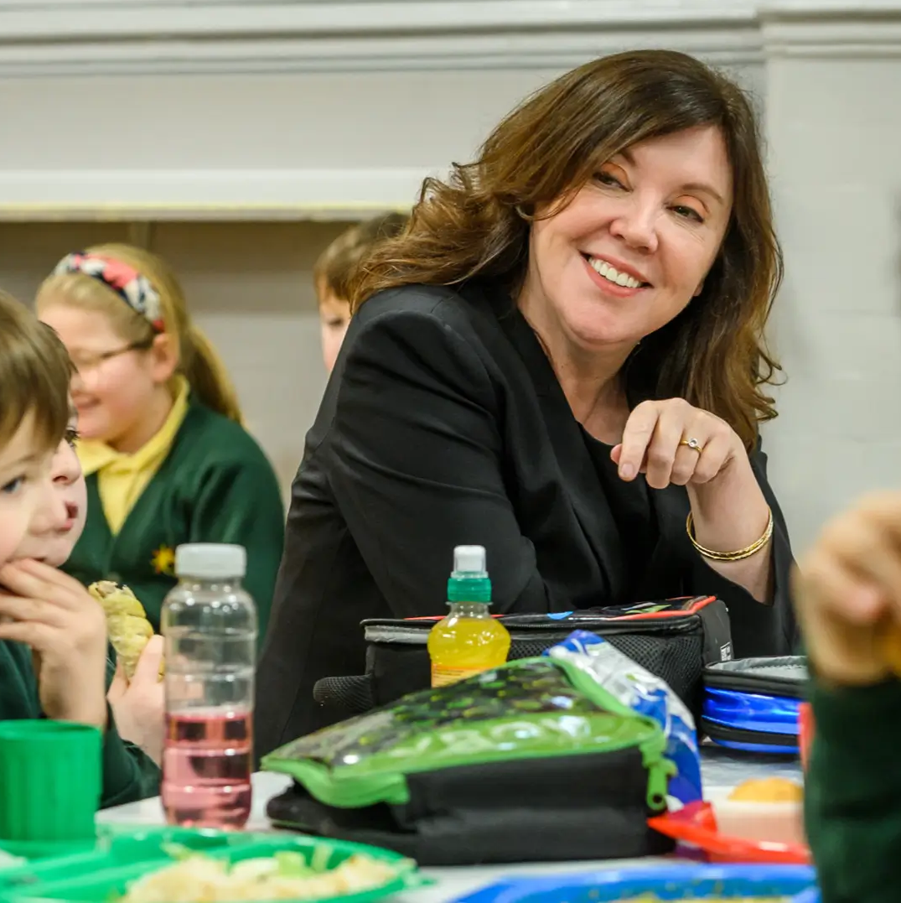
Who is the Children’s Commissioner?

Slide 3
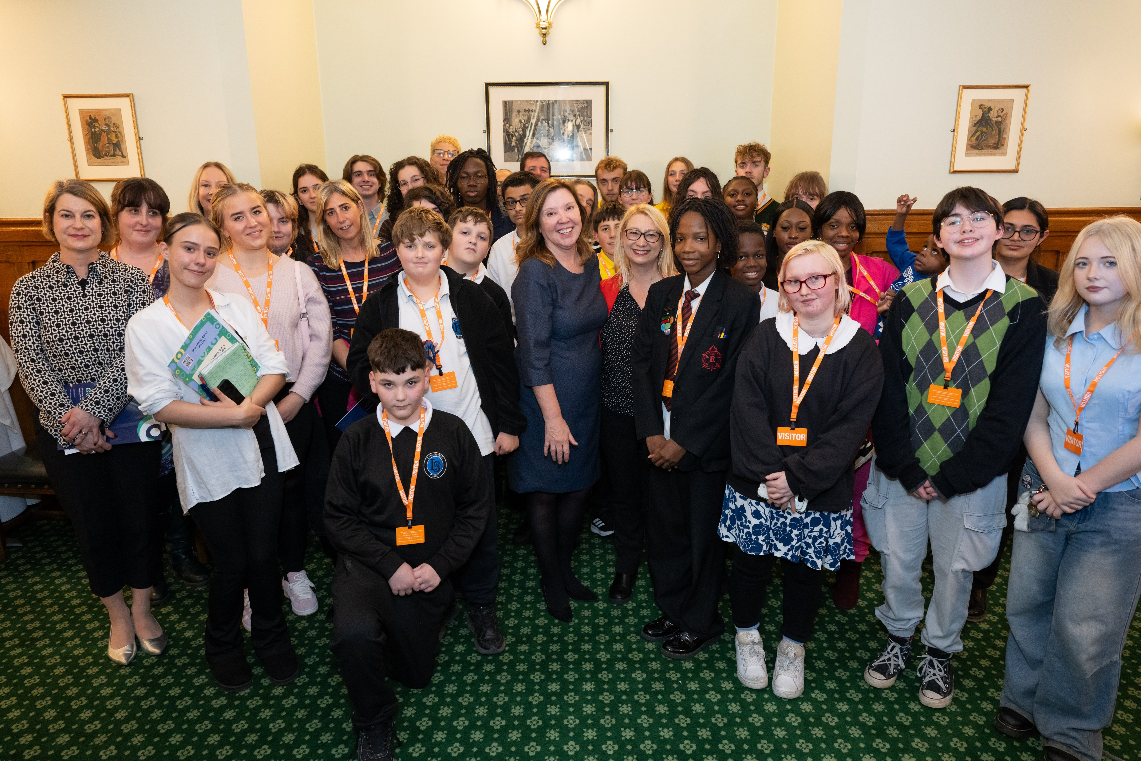
The Children’s Commissioner listens to children

Slide 4

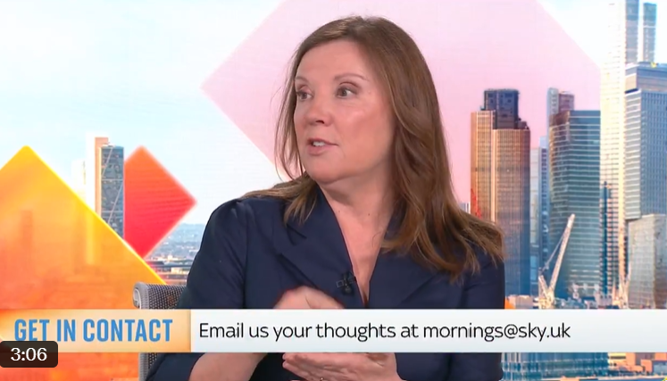
…then tells people who make decisions what children think

Slide 5
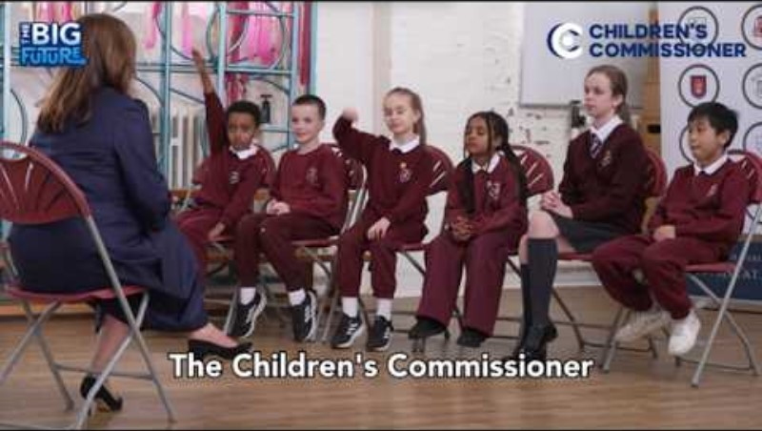
The Children’s Commissioner needs to hear from you
https://youtu.be/ESVZYc6LddI

Slide 6
Take part in The Big Future and have your voice heard!
The Children’s Commissioner has launched The Big Future, to hear from all children across England on what you think is important!

Slide 7
Try this:
Imagine you could create a world designed for children and young people. What would it look like and what would you be able to do?
Draw, write, talk with a partner about what your world would look like and the things you could do.

Slide 8
What would make your local area better?
I think our local area needs…
I wish we had a…
We need a… because…

Slide 9

What should the government do to make your future better?

Slide 10
Have your say!
Please fill out The Big Future and tell the Children’s Commissioner what needs to change!
Take part now:
childrenscommissioner.gov.uk/thebigfuture
You don’t have to answer any question if you don’t want to.
Remember, this is not a test. There are no right or wrong answers. Just answer honestly!
The survey is anonymous, so your responses are kept private.
The survey is for anyone 0-18 years old.
It should take about 5 minutes.

Slide 11



Thank you for taking part!
We will share what children have told Rachel in The Big Future with you early next year.
Youth Voices Hub
Find out what children and young people have to say on the topics that matter most to them and hear more about Rachel’s work:
childrenscommissioner.gov.uk/youth-voices

