Slide 2
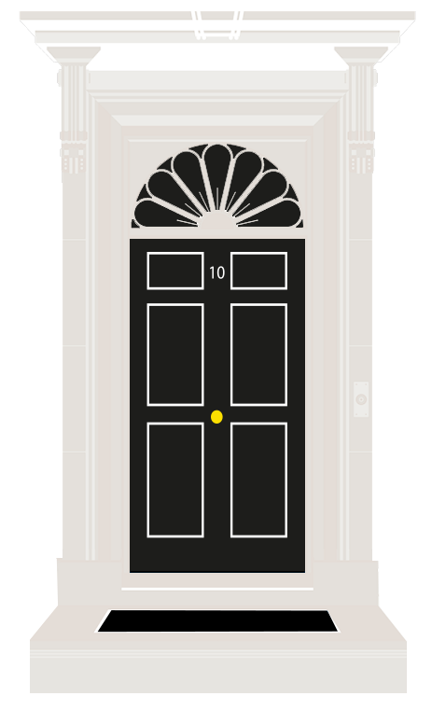
Think about/discuss
What does the government do for children and young people? List as many things as you can think of.
What should the government do to make your future better?

Slide 3
Key Terms
Children’s Commissioner: The Children’s Commissioner is an independent person whose job is to protect and promote the rights and welfare of children. They speak up for young people and make sure their voices are heard by the government.
Government: The government is a group of people led by the Prime Minister elected to make laws and take decisions on behalf of everyone on issues like education, taxes, and health.
General election: A general election is when voters decide who their member of parliament (MP) will be.
Survey: A way of collecting information by asking people questions. This is often done using questionnaires or interviews to find out opinions, experiences, or facts.

Slide 4
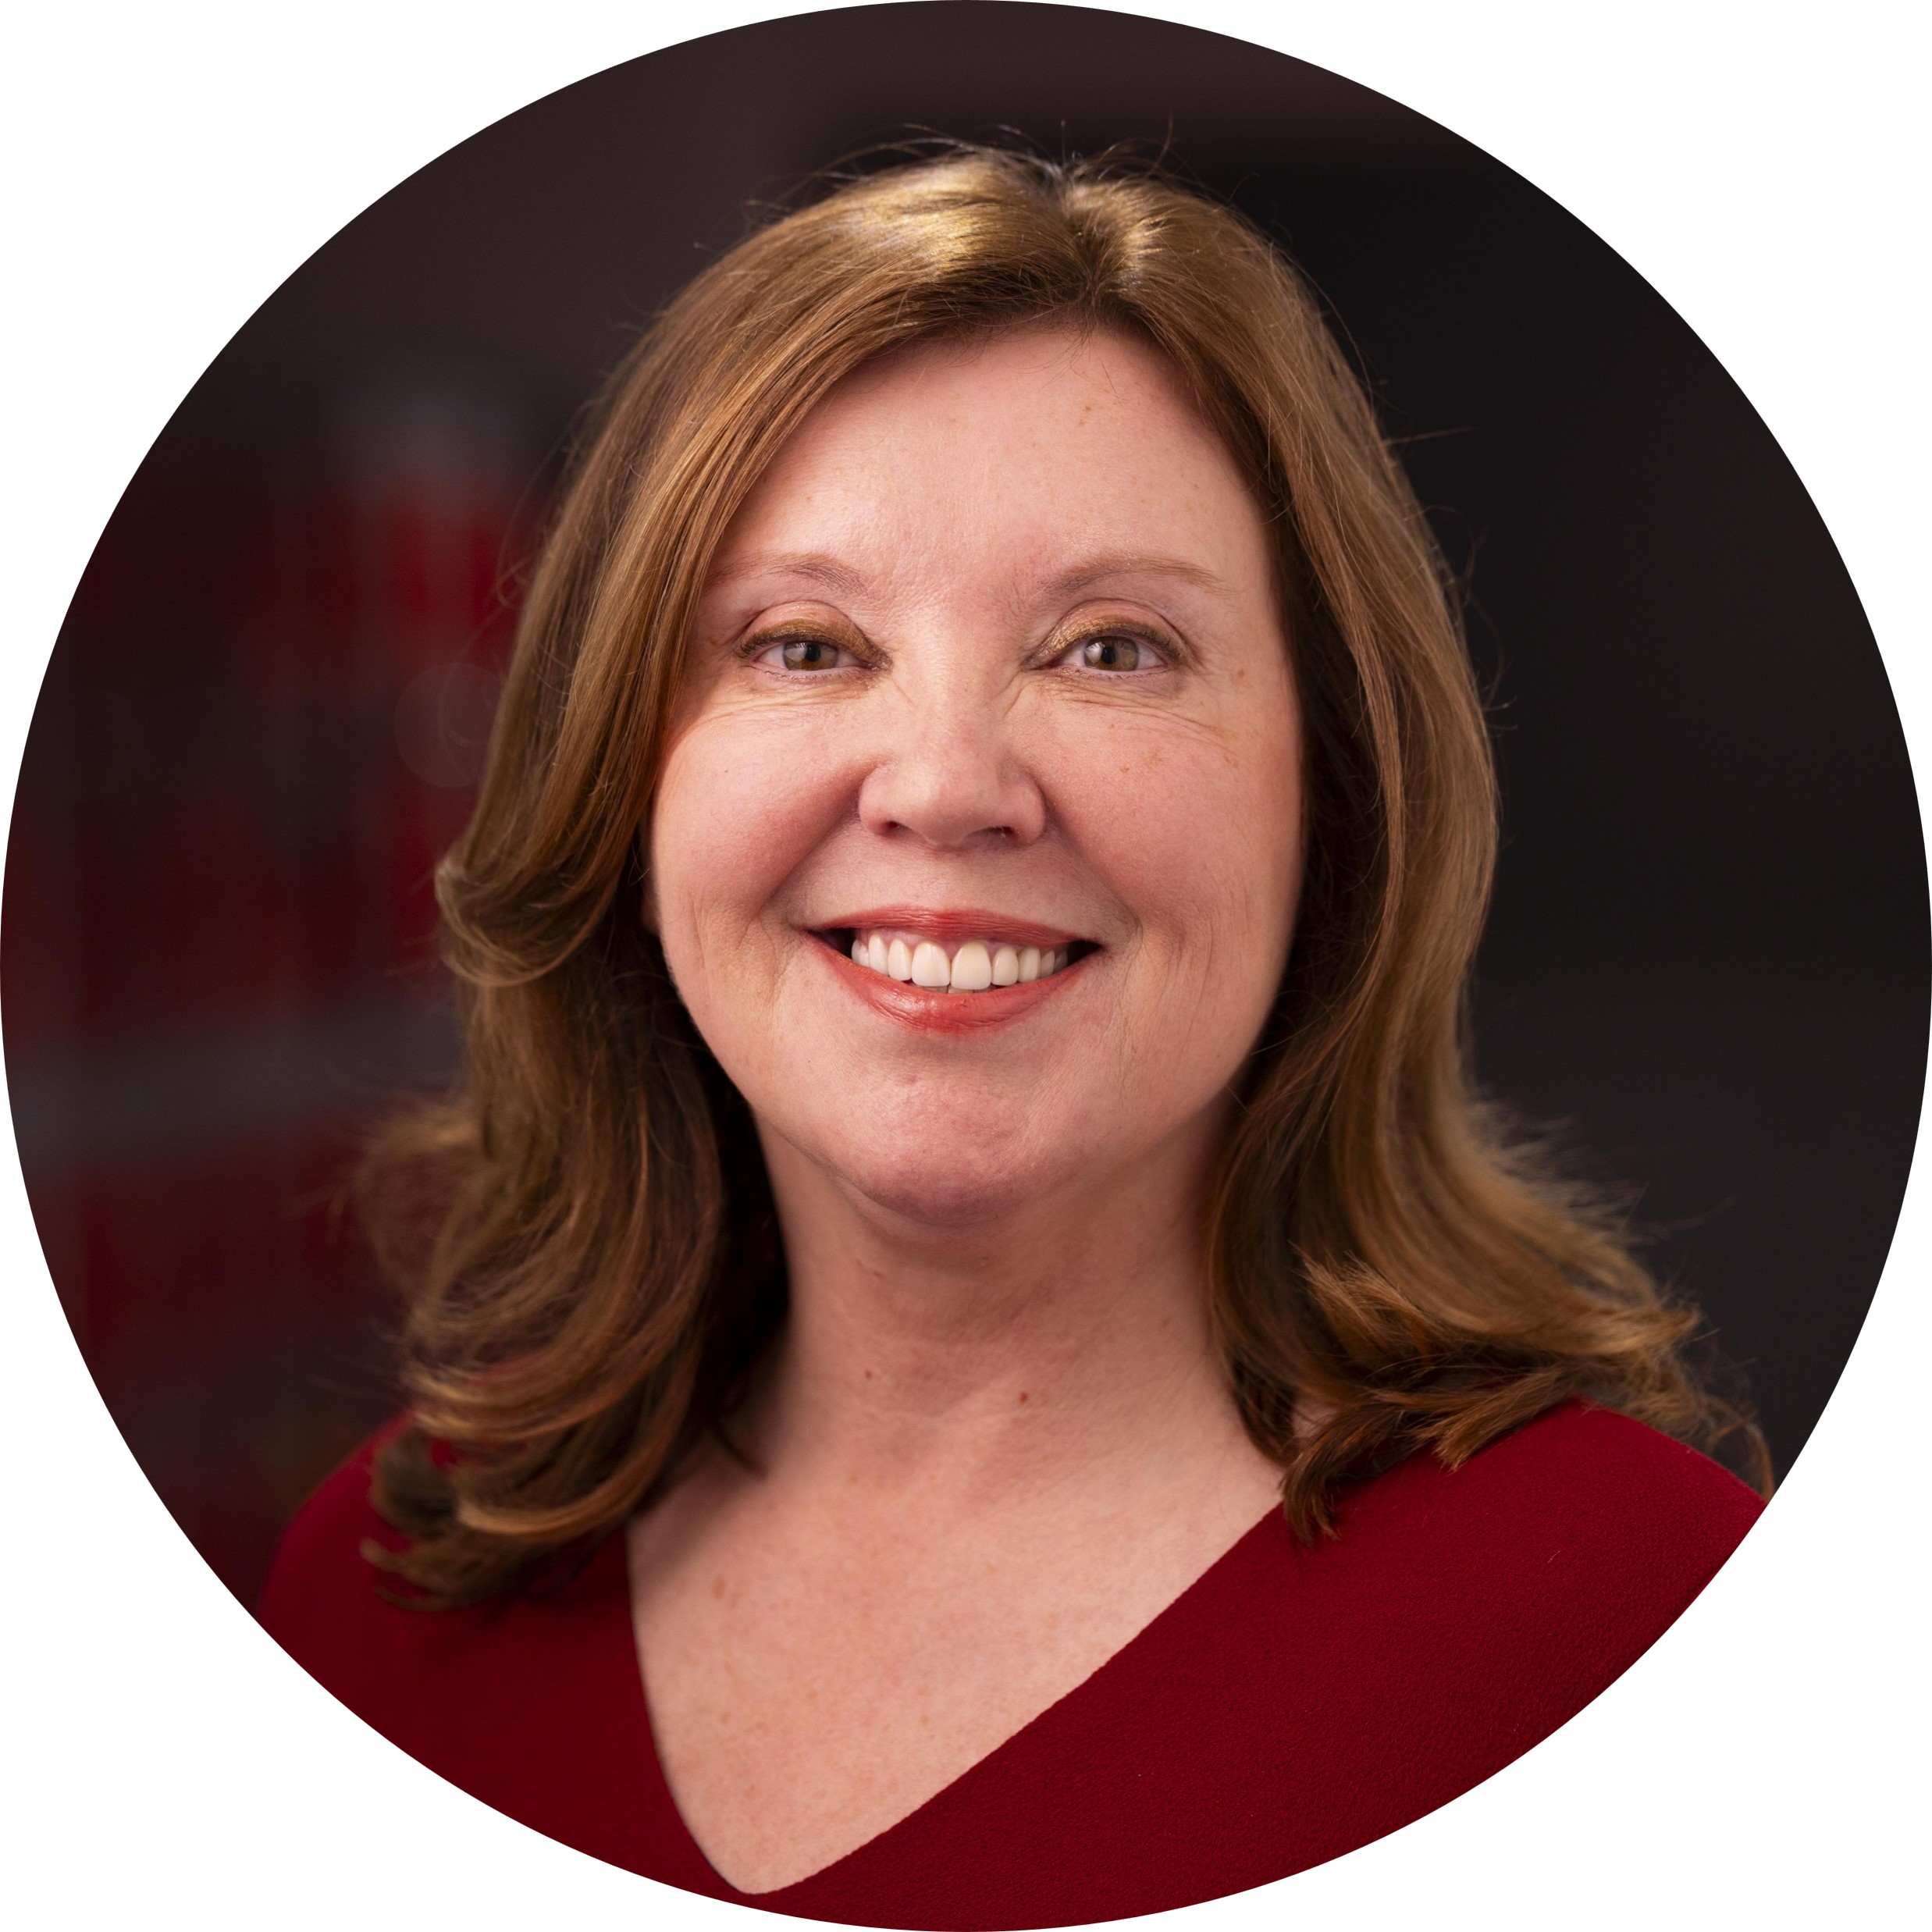
Dame Rachel de Souza is the
Children’s Commissioner
Rachel listens to children and young people’s views.
She then works to ensure that your voices are heard by the government.

Slide 5
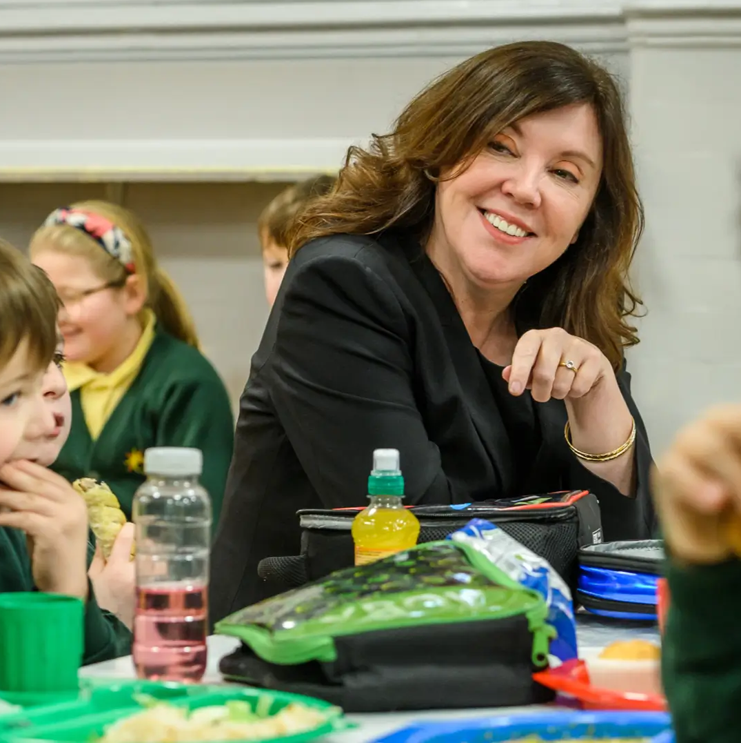
Dame Rachel speaks up for children and young people
She listens to your views and opinions and makes sure that the government hears them and acts in your interest.
She ensures your voices are heard in Parliament and the media.

Slide 6
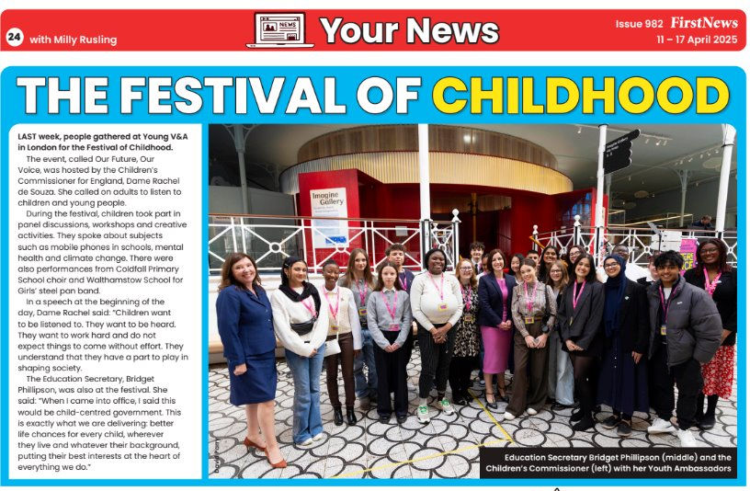
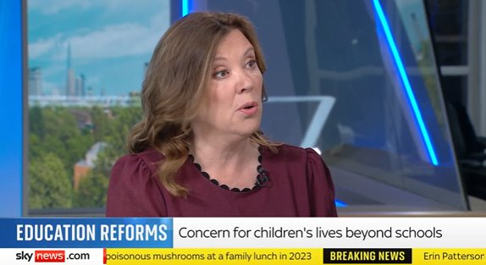
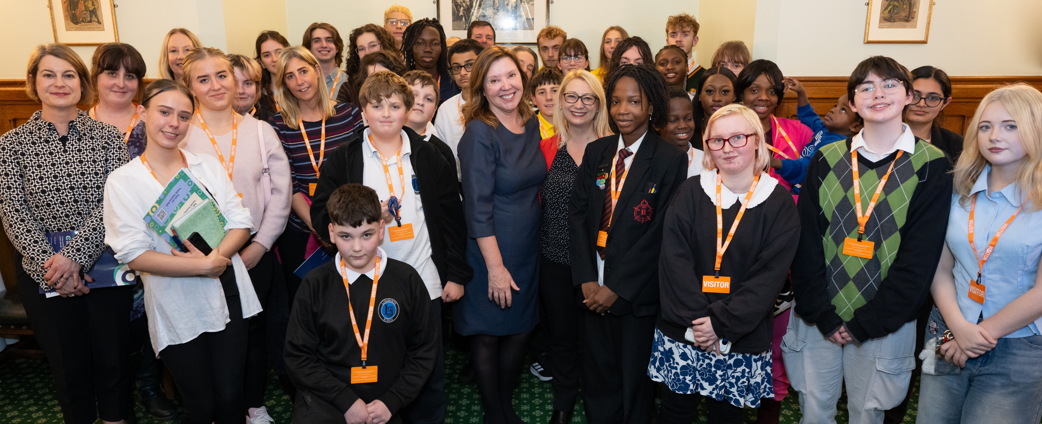
Why is she important to me?
Real change can be made because of what you tell Rachel.
Young people told her they are worried about their experiences online, especially in terms of harmful content and pressures around appearance.
Rachel is now working with the Government on harmful content regulation, via the Online Safety Act, to make you safer online.

Slide 7
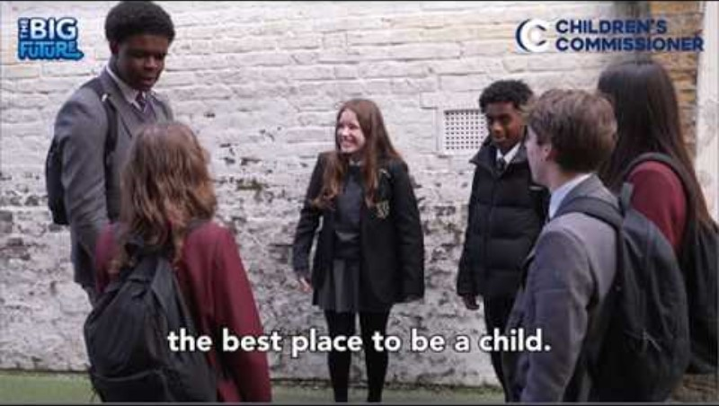
Now, the Children’s Commissioner needs to hear from you!
https://youtu.be/LxzqlU8l5Es

Slide 8
Have your say in The Big Future survey
Rachel has launched The Big Future survey to hear from children and young people across England.
She wants to know how to make your lives better in the future, the big challenges growing up, and how prepared you feel to vote and be adults.
She will take your thoughts, opinions and ideas to decision-makers and politicians to make sure the government hear your voices.

Slide 9
Before we answer the Big Future Survey, let’s get thinking!
Think about your local area (where you live).
  What’s good about living here?
  What would you change to make it better?
Think about yourself.
  What should the government do to make your future better?
  What would improve your life?

Slide 10
The Big Future Survey: We want to hear from you
Main Task
Complete the survey here:
childrenscommissioner.gov.uk/thebigfuture
The survey will first ask some personal information about yourself, before asking for your views and opinions.
This survey is anonymous, all of your responses will be kept private.
This is not a test, there are no right or wrong answers.
You do not have to answer every question. You can leave questions blank.
Additional task
Imagine you were designing your local area for children and young people to thrive. What would be your top priorities?

Slide 11



Thank you for taking part!
We will share what children have told Rachel in The Big Future with you early next year.
Youth Voices Hub
Youth Voices Forum
Find out what children and young people have to say on the topics that matter most to them and hear more about Rachel’s work.
childrenscommissioner.gov.uk/youth-voices
13+? Sign up for opportunities to have your say on issues that affect you, to get involved with Rachel’s work and speak directly to government & public bodies.
childrenscommissioner.gov.uk/youthvoicesforum

